Slide 1
Chapter- 2 Pixel Relationships
Ashis Pradhan
CSE DEPARTMENT, SMIT

Slide 2
Agenda
What is pixel neighborhood & Different types of Neighborhood?
What is meant by Connectivity?

Slide 3
Neighborhood of Pixel
A pixel P at location (x, y) has two horizontal and vertical neighbors.
This set of four pixel is called 4-neighbors P=N₄(P)
Each of this neighbors is at a unit distance from P.
If P is a boundary pixel then it will have less no. of pixels.
(X-1,Y)
(X,Y-1)
P (X,Y)
(X,Y+1)
(X+1,Y)

Slide 4
Diagonals & 8-Neighbors
A pixel P at location (x, y) has diagonal neighbors = N_{D}(P)
The points of N₄(P) & N_{D}(P) together are called 8- neighborhood of P.
N₈(P)= N₄(P)U N_{D}(P)
If P is a boundary pixel then both N_{D}(P) and N₈(P) will have less no. of pixels.
(X-1,Y-1)
(X-1,Y+1)
P (X,Y)
(X+1,Y-1)
(X+1,Y+1)

Slide 5
Connectivity
Connectivity between pixel is a important concept.
It is very useful for:
Establishing object boundaries.
Defining image components/region, area of object, etc (any other object descriptor)
If F(x,y) >Th
(x,y) ɛ Object
Else
(x,y) ɛ Background

Slide 6
What is Connectivity?
Two pixels are said to be connected, if they are adjacent in some sense:-
They are neighbors(N_{4,} N_{D} and N₈) &
Their intensity values(gray levels) are similar
Eg: For a binary image B, two points P & Q will be connected if Q ɛ N(P) or if P ɛ N(Q) and B(P)=B(Q)
 | Q
 | P
 |  | Q
 | P
 | P | Q

Slide 7
Types of Connectivity
Let V be the set of gray levels used to define connectivity for two points p, q ɛ v; three different types of connectivity are defined:
4-Connectivity => p,q ɛ v & p ɛ N₄(q)
8-Connectivity => p,q ɛ v & p ɛ N₈(q)
M-connectivity(mixed)
p, q are m connected, iff
q ɛ N₄(p) OR
q ɛ N_{D}(p) & N₄(p)∩ N₄(q) =ɸ
Where, N₄(p)∩ N₄(q) are set of pixels that are 4-neighbors of both p & q and whose values are from v.

Slide 8
Mixed connectivity is the modification of 8- connectivity
Eliminates multiple path connection that arises with 8-connectivity.
Eg. v={1}
4-connected 8-connected m-connected
 | 1 | 1
 | 1
 |  | 1
 | 1 | 1
 | 1
 |  | 1
 | 1 | 1
 | 1
 |  | 1

Slide 9
Adjacency
Two pixel p & q are adjacent if they are connected.
4 -adjacent
8 -adjacent
m –adjacent
Depending of the type of connectivity used.
Two image subsets S_{i &} S_{j} are adjacent if Ǝ p ɛ S_{i} and Ǝ q ɛ S_{j} , such that p & q are adjacent.

Slide 10
Digital Path
A digital path from pixel p with coordinates (x, y) to pixel q with coordinates (s,t) is sequence of distinct pixels with coordinates
(x₀,y₀), (x₁,y₁), (x₃,y₃), …………, (x_{n},y_{n})
where (x₀,y₀) = (x,y) and (x_{n},y_{n}) = (s,t)
(x_{i},y_{i}) and (x_{i-1},y_{i-1}) are adjacent for 1 ≤ i ≤ n. In this case, n is the length of the path.
If (x₀,y₀) = (x_{n},y_{n}), the path is closed path.

Slide 11
Eg: Shortest m-path:
Let us consider adjacency of pixels valued 1 (V ={1}). Consider the following arrangement of pixels p, p₂, and p₄ have value 1 and p₁ and p₃ can have a value of 0 or 1:
p₃ p₄
p₁ p₂
p
If p₁ and p₃ are 0, the length of the shortest m- path between p and p₄ is 2. (p p₂ p₄)
If p₁ = 1 and p₃ = 0, the length of the shortest m- path between p and p₄ is 3. (p p₁ p₂ p₄)
If p₁ and p₃ are 1, the length of the shortest m- path between p and p₄ is 4. (pp₁p₂p₃p₄)

Slide 12
Connected Component
Let S represent a subset of pixels in an image.
Two pixels p and q is said to be connected in S if there exists a path between them consisting entirely of pixels in S.
For any pixel p in S, the set of pixels that are connected to it in S is called Connected components of S.
If it has only one connected components then the set S is called Connected Set.

Slide 13

Disjoint Connected Component
Distinct Connected component are disjoint.
For disjoint connected component=> assign different label to them.
Connected component labeling is the fundamental step in automated image analysis like: shape, area, boundary or its related feature.

Slide 14
Definition of Basic terms of an Image
Region:
Let R be a subset of pixels in an image. We call R a region of an image if R is a Connected Set.
Boundary:
The boundary of region R is the set of pixels in the region that have one or more neighbors that are not in R.
If R happens to be an entire image, then its boundary is defined as the set of pixels in first and last row and column of images.
Boundary of finite region forms a closed path and then is global concept.
Edge:
Edges are formed from pixels with derivatives values that exceed a preset threshold. Edges is local concept that is based on a measure of gray level discontinuity at a point.

Slide 15
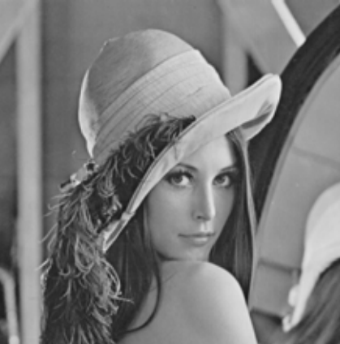



Difference between Edge & Boundary
Edge | Boundary
Input: | Input:
Output: | Output:

Slide 16
// Disjoint Connected Component Labeling ALGORITHM
ASSUME:
I(p)=> pixel value at position p
L(p)=>level assigned at pixel location p
Step1: If I(p)= 0, then
//Move to next scanning position
Step2: If I(p)= 1 AND I(r) = I(t) = 0, then
//Assign new level to position p
Step3: If I(p)=1 and Only one of the neighbor (r or t) have value = 1
// Assign IT’S level to p
Step4: If I(p)=1 AND both r and t = 1, then
4.1: if L(r) = L(t), than L(p) = L(r)
4.2: if L(r) ≠ L(t), than
//Assign one of the label to p and make note that the two levels are equivalent.
Step5: Repeat Step 1 to 4, until all pixels of an Image are traversed.

Slide 17
ASSIGNING GRAY LEVEL ALGORITHM DEMONSTRATION
 |  |  |  |  |  |  |  |  |  |  |  |  |  |  |  |  |  |  |  |  | Record
 |  |  |  |  | PASS 1
Step1 |  |  |  | 1 |  |  | 2 |  |  |  |  | 3 | 3
 |  |  |  | 1 |  |  | 2 |  |  |  | 4 | 4 | 4 | 4 |  |  |  |  |  |  |  | (3,4)

Slide 18
Step2 |  |  |  | 1 |  |  | 2 |  |  |  |  | 3 | 3
 |  |  |  | 1 |  |  | 2 |  |  |  | 4 | 4 | 4 | 4 |  |  |  |  |  |  |  | (3,4)
 |  |  |  | 1 | 1 | 1 | 1 |  |  |  |  | 4 |  | 4 |  |  |  |  |  |  |  | (2,1)
 |  |  |  |  | 1 | 1 |  |  |  |  |  | 4 | 4 | 4
 |  |  |  | 5 | 5 |  |  |  |  |  |  |  |  |  |  |  |  |  |  |  |  | (5,1)
 |  |  |  | 5
 |  |  |  |  |  | PASS 2
 |  |  |  | 1 |  |  | 1 |  |  |  |  | 4 | 4
 |  |  |  | 1 |  |  | 1 |  |  |  | 4 | 4 | 4 | 4
 |  |  |  | 1 | 1 | 1 | 1 |  |  |  |  | 4 |  | 4
 |  |  |  |  | 1 | 1 |  |  |  |  |  | 4 | 4 | 4
 |  |  |  | 1 | 1
 |  |  |  | 1

Slide 19
Distance Measures
Distance Properties:
For pixels p, q, and z, with coordinates (x, y), (s, t) and (v, w), respectively, D is a distance function or metric if
a) D (p, q) ≥ 0 (D (p, q) = 0 iff p=q)
b) D (p, q) = D (q, p)
c) D (p, z) ≤ D (p, q) + D (q, z)
Euclidean Distance:
The distance between p and q is defined as
D_{e} (p, q) = [ (x-s)² + (y –t)²]^{1/2}
The pixels having a distance less than or equal to some value r from (x, y) are the points contained in a disk of radius r centered at (x, y).

Slide 20
Basic Relationship between pixels
D₄ Distance (City Block Distance):
The distance between p and q is defined as
D₄ (p, q) = |x - s| + |y – t|
The pixels having a D₄ distance less than or equal to some value r from (x, y) forms a diamond centered at (x, y)
For example, the pixels with D₄ distance ≤ 2 from (x, y) form the following contours of constant distance:
2
2 1 2
2 1 0 1 2
2 1 2
2

Slide 21
Basic Relationship between pixels
D₈ Distance (Chessboard Distance):
The distance between p and q is defined as
D₈ (p, q) = max (|x - s| , |y – t|)
The pixels having a D₈ distance less than or equal to some value r from (x, y) forms a square centered at (x, y)
For example, the pixels with D₈ distance ≤ 2 from (x, y) form the following contours of constant distance:
2 2 2 2 2
2 1 1 1 2
2 1 0 1 2
2 1 1 1 2
2 2 2 2 2

Slide 22




Application of Distance Measure
SHAPE MATCHING

Slide 23
Consider the two image subsets S₁ and S₂ shown in the following figure. For V={1}, determine whether these two subsets are
(i) 4- adjacent (ii) 8- adjacent (iii) m –adjacent
S₁ S₂
0 0 0 0 0 0 0 1 1 0
1 0 0 1 0 0 1 0 0 1
1 0 0 1 0 1 1 0 0 0
0 0 1 1 1 0 0 0 0 0
0 0 1 1 1 0 0 1 1 1
Consider the image segment shown
(a) Let V = { 0,1} and compute the lengths of the shortest 4- 8- and m- path between p and q. if the particular path does not exist between these two points, explain why.
(b) Repeat for V={1,2}
(c) Calculate D_{e}, D₄ and D₈ between p and q
3 1 2 1(q)
2 2 0 2
1 2 1 1
(p)1 0 1 2

Slide 24
ARITHMETIC & LOGICAL OPERATION

Slide 25
Image Operation on Pixel Basis :
All arithmetic and logical operation between two image are performed between corresponding pixels in the images involved.
For Example:
Dividing image f by image g is done by simply the first pixels in f divided by the first pixel in g.
Linear and Nonlinear Operation:
Let H be an operator whose input and output are images, H is said to be a linear operator if, for any two images f and g and any two scalars a and b,
H(af+ bg) = aH(f) + bH(g)
An operator that fails the test of above equation is by definition Nonlinear.

Slide 26
Arithmetic & Logical Operation
Following are arithmetic/logical operations that can be performed between two pixel p & q.
Note: Logical operation can be applied to binary image only, on pixel by pixel basis.
Arithmetic | Logical
p + q | p . q
p – q | p + q
p * q | P ‘
p / q

Slide 27
Arithmetic Operation
Of the four arithmetic operations, Subtraction and Addition are the most useful for Image enhancement.
Division of two images are performed by multiplication of an Image by the reciprocal of the other Image.
Multiplying an Image by a constant to increase its average gray level are also helpful in Image enhancement
Image subtraction/addition : g (x,y) = f(x,y) -/+ h(x,y)
Image multiplication : g (x,y) = f(x,y) * h(x,y)
g (x,y) = a *f(x,y)
Image Division : g (x,y) = f(x,y) * [h (x,y)] -1

Slide 28
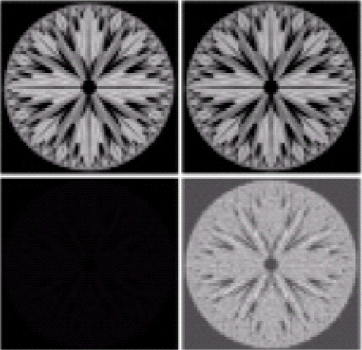
Image subtraction
The difference between two images f(x, y) and h x,y), expressed as
g(x, y) = f(x, y) – h(x, y)
The key use of subtraction is the enhancement of the differences between images.
a b
c d
Figure a) Original fractal Image b) result of setting four lower order bit planes to zero. c) difference between (a) and (b). d)Histogram equalized difference image.

Slide 29
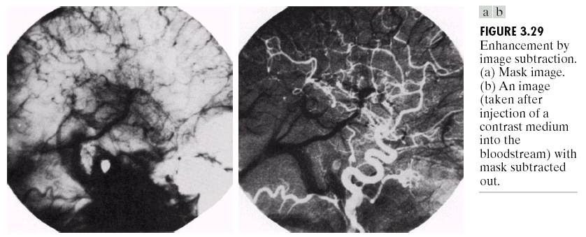
Application of image subtraction
Area of medical imaging called mask mode radiography
In this case, h (x, y ), the mask is an x-ray image of the a patient’s body.
f(x, y) is the series of images obtained by injecting a contrast medium into patient’s blood stream.

Slide 30
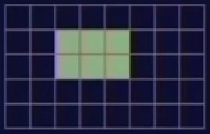
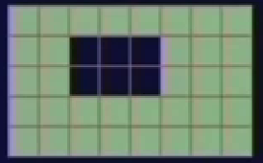
Example’s of Logical Operation
NOT (A)
Image ‘A’

Slide 31
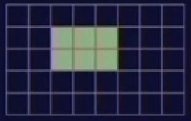
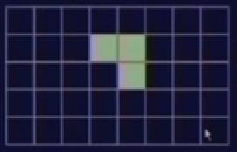
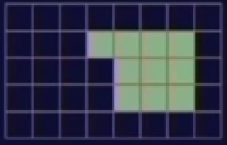
Example’s of Logical Operation(Contd..)
Image ‘A’
A (AND) B
Image ‘B’

Slide 32
Enhancement using Arithmetic and Logical Operations
For example, performing NOT operation on a gray scale images produces complementary series of binary pattern.
NOT logic operator performs the same function as the Negative transformation.
AND/NAND and OR/NOR operators are used for masking, i.e. for selecting sub=images in an image as shown in the next slide.
In terms of enhancement masking is used to isolate an area for processing/ highlighting.

Slide 33



AND OPERATION
AND
=
Although we wanted the moved object to disappear from the resulting image, it appears twice, at its old and at its new position. The reason is that the object has rather low pixel values whereas the background has a high values.

Slide 34

AND OPERATION
Solution to problem:
To obtain the desired result we have to invert the images before ANDing them, as it was done in the above figure. Only the object which has the same position in both images is highlighted.

Slide 35




AND OPERATION
=
Inversion
AND
Solution to problem:
To avoid these problems, it is best to produce a binarized image from the input grayscale images using thresholding, and then apply AND operation.

Slide 36


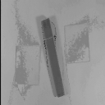


AND OPERATION
AND
=
However, if the second scene is somehow like
AND
=
When the average intensity of one object in the scene is higher than the background and the other object in the scene being lower than the background then ANDing the grayscale images is not successful either because we can’t apply thresholding.

Slide 37
Application of AND operator

Slide 38



In general, applying the AND operator (or other logical operators) to two images in order to detect differences or similarities between them is most appropriate if they are binary or can be converted into binary format using thresholding.
One of the common uses for AND is for masking. For example, suppose we wish to selectively brighten a small region of the adjacent image to highlight a particular car.
First a paint program is used to identify the region to be highlighted. In this case we set the region to black as shown in
This image can then be thresholded to just select the black region, producing the mask shown in figure

Slide 39


The mask image has a pixel value of 255 (11111111 binary) in the region that we are interested in, and zero pixels (00000000 binary) elsewhere. This mask is then bitwise ANDed with the original image to just select out the region that will be highlighted. This produces
Finally, we brighten this image by scaling it by a factor of 1.1, dim the original image using a scale factor of 0.8, and then add the two images together to produce the image highlighting the car.

Slide 40

OR OPERATION
This image shows only the position of the object which was at the same location in both input images.
The reason is that the objects are represented with logically 0 and the background is logically 1.
Hence, we actually OR the background which is equivalent to NANDing the objects.
thresholding
OR
thresholding

Slide 41



OR OPERATION (contd..)
invert
Now, the output shows the position of the stationary object as well as that of the moved object.
OR
invert

Slide 42
Application of OR operator

Slide 43




OR is often used to merge two images together
a | b
c | d
Figure: a) Original Image b) Image histogram c) Histogram resized to original image size d) ORed image of a and c.

Slide 44
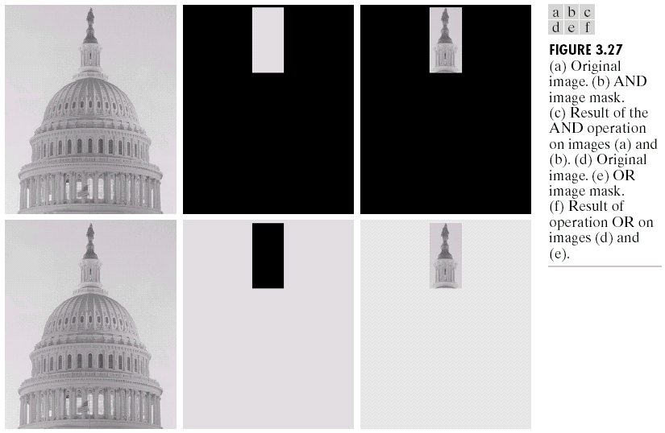

Slide 45
Neighborhood Operation
The values assigned to a pixel is a function of its gray label and gray label of its neighbors.
Z=1/9 * (Z₁ + Z_{1…….} + Z₉ ) = Average
Z₁ | Z₂ | Z₃
Z₄ | Z₅ | Z₆
Z₇ | Z₈ | Z₉

Slide 46

Template (Neighborhood Operation…Contd)
In general form:
Z = (W₁Z₁ + W₁Z_{1…….} + W₁Z₉ )
=
Same as averaging, if W_{i} = 1/9
Z₁ | Z₂ | Z₃
Z₄ | Z₅ | Z₆
Z₇ | Z₈ | Z₉
W₁ | W₂ | W₃
W₄ | W₅ | W₆
W₇ | W₈ | W₉

Slide 47
Application of Neighborhood Operation
The various important operation can be implemented by proper selection of coefficient, W_{i}
Noise filtering,
Thinning,
Edge detection, etc.

Slide 48
THANK YOU….. Any Questions ???

